Slide 1
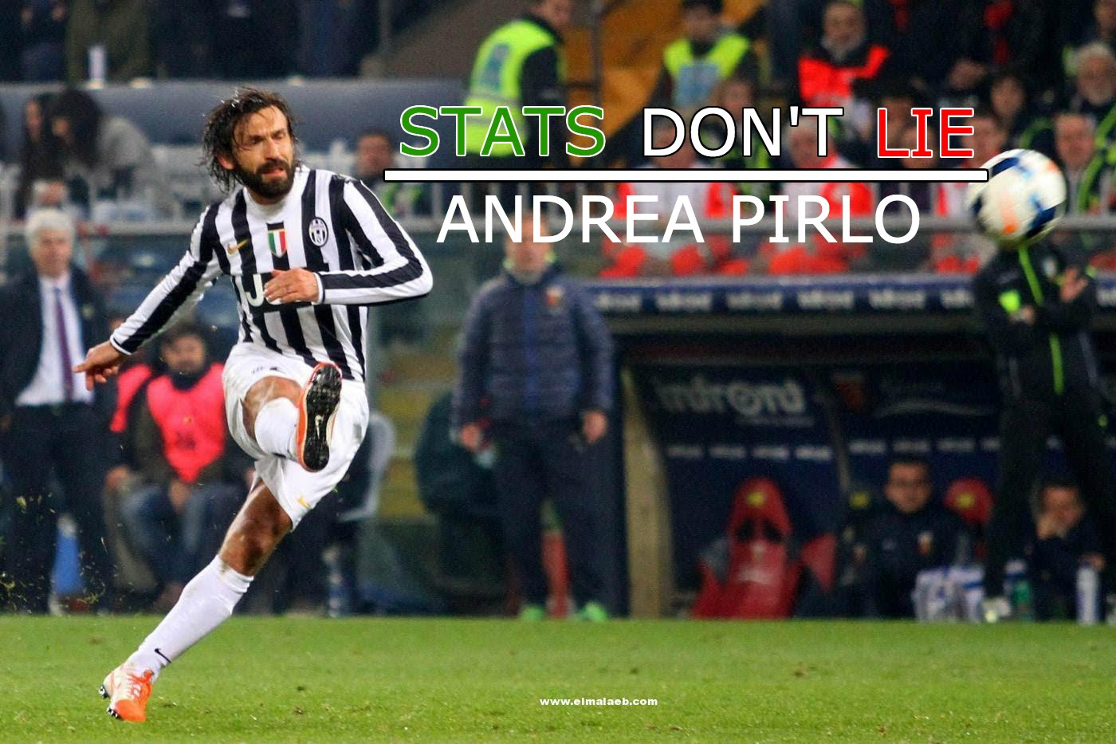

Predicting soccer scores for the sake of gambling science
Prepared by Jurgen Xhafaj

Slide 2
Data
Data was collected by soccer databases from Kaggle (courtesy of Hugo Mathien) and football-data.co.uk.
The data has the following properties:
+25,000 matches
11 European Countries with their lead championship
Seasons 2008 to 2016
Team line up with squad formation (X, Y coordinates)
Betting odds from up to 10 providers
Detailed match events (goal types, possession, corner, cross, fouls, cards etc...) for +10,000 matches

Slide 3

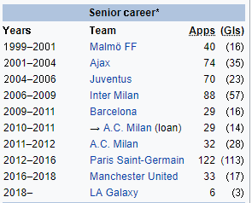
Leagues
Belgium Jupiler League
England Premier League
France Ligue 1
Germany 1. Bundesliga
Italy Serie A
Netherlands Eredivisie
Poland Ekstraklasa
Portugal Liga ZON Sagres
Scotland Premier League
Spain LIGA BBVA
Switzerland Super League

Slide 4
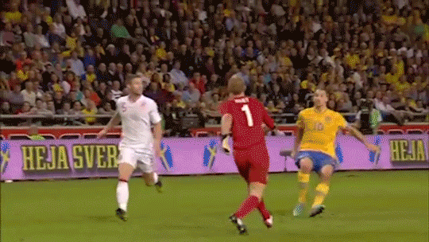
Also Ibrahimovic…

Slide 5
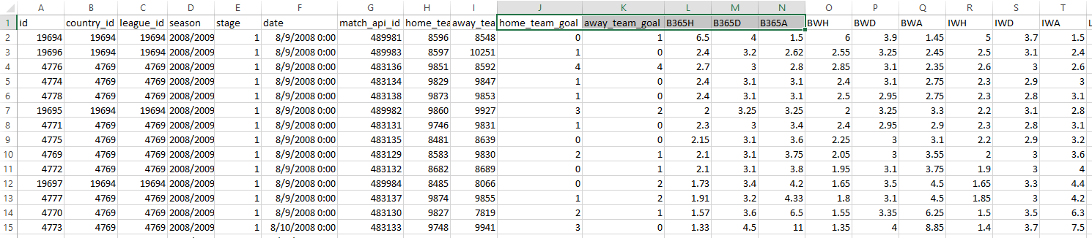
Snippet from the data
“They say one in every seven friends have a gambling addiction. My money’s on Dave.”

Slide 6
Objectives
The first objective is to predict the number of overall goals scores on a match. Betting options are as follows:
0-2 goals
3+ goals (3 or more)
Note: The games were all national league games, so overtime and penalty shootouts were not issues in this case, because there is no overtime or penalty shootouts in such games.
The second objective is to actually predict the outcome of a match. Betting options are as follows:
1 (Home team wins after regular time)
X (The game ends in a tie/draw)
2 (Away team wins after regular time)
The third objective is to find out which lineups work the best in home games, as well as away games.

Slide 7

How good are other predictions? (quote from database author)
The Holy Grail... ... is obviously to predict the outcome of the game. The bookies use 3 classes (Home Win, Draw, Away Win).
They get it right about 53% of the time. This is also what I've achieved so far using my own SVM. Though it may sound high for such a random sport game, you've got to know that the home team wins about 46% of the time.
So the base case (constantly predicting Home Win) has indeed 46% precision.

Slide 8
Selecting the relevant data
Analyzing the columns and checking which are going to help in making predictions
Here, the betting coefficients columns contain data given prior to the match, so it is reasonable to include them.
The team names have not been taken into account because certain teams win much more than others do.
League code is not considered because certain leagues have overall much better/worse teams.
Some matches have a lot of betting coefficients and some others do not. However, coefficients from Bet365 company were as good alone as combined with other predictions.
Creating new columns
Using functions to adapt data for each specific prediction

Slide 9
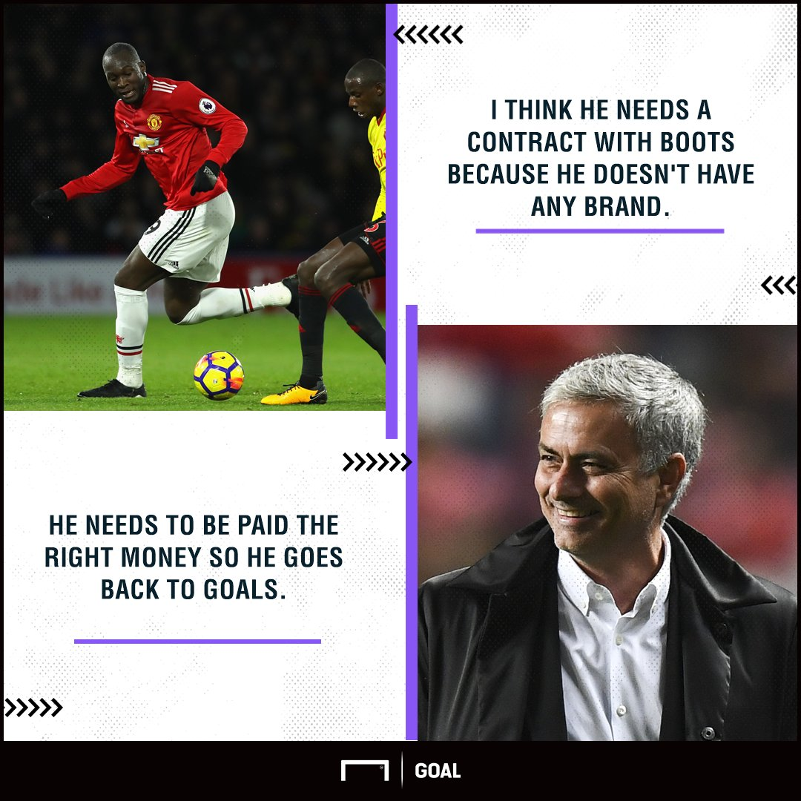
What would help?
The following information would certainly help get better results for our prediction. I did find some information, but it was partial and very limited.
Team’s manager and their service record (Mourinho, Ancelotti, Guardiola, etc)
Team’s formation (5-4-1, 4-4-2, 4-3-3, etc.)
Weather conditions (favors certain teams)
The players who would participate in the match.
This data was very vaguely represented in a table and its entries were lacking in most of the cases.

Slide 10

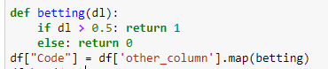
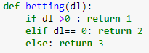
Manipulating data
Creating new column for each objective
If home team wins: “other_column” = home_team_goal – away_team_goal
The number of goals: “other_column”=home_team_goal + away_team_goal
Create a betting function for each objective:
Predicting if home team wins
Predicting the number of goals

Slide 11
Preparing for models
X,y columns
Input included betting coefficients, provided several days before each match.
Outcome was specific for each goal of the project
MinMaxScaler to scale data
Separating data into training and testing data (80%:20%)

Slide 12
The models and their prediction accuracy (%)
Note: I used 10 fold cross validation.
Neural network
With 3 outcomes: 35-36%
(if home team wins or not):53%
For most cases, I used sigmoid as the activation function
Grid search was run for the following parameters:
batch_size (10,15,20), epochs(5,10,15), time: ~2 minutes
batch_size (7,10,14), epochs(10,20,30), time: 368 seconds
optimizer (SGD, RMSprop, Adagrad, Adadelta, Adam, Adamax, Nadam) time: 1146 seconds
Initial weights: init_mode(uniform, lecun_uniform, normal, zero, glorot_normal, glorot_uniform, he_normal, he_uniform)
activation (softmax, softplus, softsign, relu, ranh, sigmoid, hard_sigmoid, linear)
Random forest (if the home team wins): 62.35%
AdaBoost : 65.15%
Stochastic Gradient Boosting : 65.18%
Voting Ensemble (Logistic Regression, DecisionTree, SVC) : 65.30%

Slide 13

Extras
I did use timer() from timeit , so I could get the total time used
I plan to add map locations for the top teams (this will be based on current data rather than overall historical rankings)
GeoMap was not working
Several packages are not updated to work with the current Python version
I might resolve to using Orange for generating the map if Python methods fail

Slide 14
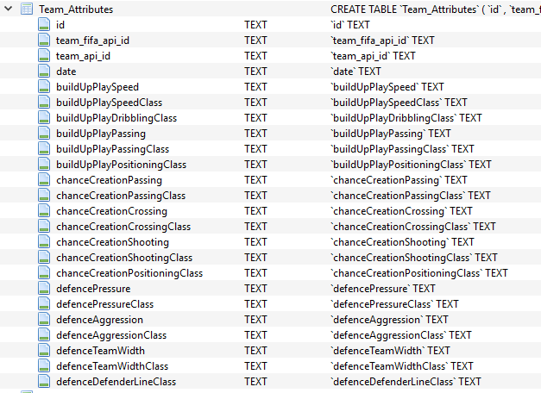
Upcoming work
Finding out which lineups work the best
Another table will be used, as visualized here→
The task will have two parts:
Best lineup to do well when playing a HOME game
Best lineup to do well when playing an AWAY game

Slide 15
Work in progress
Data visualization for the current dataset and (optionally) overall historical statistics
Optimizing algorithms to get higher prediction scores:
This includes adding more columns
Grid search more parameters
Add more layers to neural network and adjust number of neurons
Trying to figure out which nation’s league matches are easier to predict. (higher prediction accuracy = safer betting)
Outcomes will also include confusion matrix representation

Slide 16
References
https://jakevdp.github.io/PythonDataScienceHandbook/04.13-geographic-data-with-basemap.html
https://pandas.pydata.org/pandas-docs/stable/generated/pandas.read_csv.html
https://www.analyticsvidhya.com/blog/2017/05/neural-network-from-scratch-in-python-and-r/
https://medium.com/technology-invention-and-more/how-to-build-a-simple-neural-network-in-9-lines-of-python-code-cc8f23647ca1
https://stackoverflow.com/questions/42815131/keras-for-implement-convolution-neural-network?utm_medium=organic&utm_source=google_rich_qa&utm_campaign=google_rich_qa
https://iamtrask.github.io/2015/07/27/python-network-part2/
https://blogs.oracle.com/meena/simple-neural-network-model-using-keras-and-grid-search-hyperparameterstuning
https://machinelearningmastery.com/grid-search-hyperparameters-deep-learning-models-python-keras/
https://datascience.stackexchange.com/questions/21877/how-to-use-the-output-of-gridsearch?utm_medium=organic&utm_source=google_rich_qa&utm_campaign=google_rich_qa
https://machinelearningmastery.com/ensemble-machine-learning-algorithms-python-scikit-learn/
https://machinelearningmastery.com/get-your-hands-dirty-with-scikit-learn-now/
https://machinelearningmastery.com/how-to-one-hot-encode-sequence-data-in-python/
DATA: https://www.kaggle.com/hugomathien/soccer ; http://www.football-data.co.uk/data.php

Slide 17
Thanks for watching!

